Slide 1

MODULE CODE & TITLE: GENML801- MACHINE LEARNING Date: 20th September 2025 RQF LEVEL: 8
DEPARTMENT: ELECTRICAL AND ELECTRONICS ENGINEERING PROGRAM: ELECTRONICS AND TELECOMMUNICATION TECHNOLOGY ACADEMIC YEAR: 2025-2026
Submission deadline: 4th October, 2025 Submission email: muflorentine3@gmail.com
Individual assignment: Applying EDA and Feature Engineering on a Dataset
NAMES: IRAKOZE Chrispin REG NO: 25RP18655

Slide 2
Problem Statement
Title: Fraud Prediction on Mobile Money Transaction
Mobile money services have become essential for daily financial activities, especially in developing regions. However, these systems face a major challenge — increasing fraudulent transactions, such as unauthorized transfers and balance manipulation.
Traditional rule-based systems are no longer sufficient, as fraudsters constantly change their methods. To address this, the project applies machine learning techniques to predict the likelihood of fraud in real-time transactions.
By analyzing transaction features such as amount, balance changes, and transaction type, the model can distinguish between genuine and suspicious activities. This approach improves financial security, reduces losses, and strengthens trust in mobile money platforms.
Dataset Description
The project uses the Pay Sim dataset found on Kaggle, a synthetic dataset that simulates real mobile money transactions based on genuine financial data collected from a mobile payment service provider.
It contains over 6 million transaction records, each representing an event such as CASH-IN, CASH-OUT, TRANSFER, PAYMENT, or DEBIT. Each record includes numerical and categorical features describing both the sender and receiver accounts before and after a transaction.
Key features used in this project include:
amount: Value of the transaction
oldbalanceOrg / newbalanceOrig: Sender’s balance before and after transaction
oldbalanceDest / newbalanceDest: Receiver’s balance before and after transaction
type: Transaction type (one-hot encoded)
isFraud: Target variable (1 = fraudulent, 0 = genuine)
Additional engineered features such as balance_change_org, balance_change_dest, and anomaly flags were derived to enhance fraud detection accuracy.
EDA Findings
Type of EDA :
Bivariate Analysis (Primary) – to explore relationships between features and the target variable (isFraud)

Slide 3
Univariate Analysis (Supportive) – to inspect distributions of individual transaction attributes
Multivariate Analysis (Complementary) – to study inter-feature relationships using correlation matrices
Why Bivariate Analysis Was Chosen?
Since the dataset is highly imbalanced (≈0.13% fraud), bivariate analysis provides the clearest way to understand which transaction features distinguish fraudulent from genuine cases. It highlights direct relationships such as transaction type vs. fraud rate or amount vs. likelihood of fraud.
Key EDA Findings:
Transaction Type Impact:
Fraud is concentrated mainly in TRANSFER and CASH_OUT transactions.
These two categories account for almost all fraudulent records, confirming they are the most critical for model training and risk monitoring.
Transaction Amount:
Fraudulent transactions typically involve larger amounts than normal operations.
The distribution is highly skewed — fraud tends to occur in high-value transfers.
Balance Behavior Patterns:
Fraud cases often show illogical balance movements, such as:
Sender’s balance increasing instead of decreasing after sending money.
No change in either sender or receiver balance despite a positive transaction amount.
Receiver’s balance decreasing during CASH_IN, which violates expected behavior.
In genuine transactions, receiver balances increase proportionally to the transferred amount, and sender balances decrease accordingly.
Correlation Patterns
Strong positive correlation between amount and oldbalanceOrg.
Negative correlation between isFraud and newbalanceOrig, confirming that fraudsters often end with low or zero balances after the transaction.
Moderate correlation among balance difference features (balance_change_org, balance_change_dest) supports the idea that balance anomalies can signal fraud.

Slide 4
Imbalance Confirmation
The dataset is extremely imbalanced — only about 0.13% of transactions are fraudulent.
This justified using class weighting and anomaly detection rules during model training and prediction.
Fraud Conditions Identified During EDA
Through deeper analysis, six consistent fraud indicators were discovered and later encoded into the Stream lit model’s rule engine:
Fraud Condition | Description
Zero amount with CASH_OUT | Unusual withdrawal with no value — high fraud risk.
Sender balance increases after sending money | Logically inconsistent; possible fraudulent manipulation.
Receiver balance decreases after CASH_IN | Indicates data or fraudulent reversal.
No balance change despite transaction | Suspicious “ghost transaction.”
Sender balance unchanged but receiver credited | Unauthorized credit or system bypass.
Sender lost more than amount sent | Hidden loss — strong indicator of fraud siphoning.
These findings became essential for feature creation and rule-based validation in the deployed model.
iv. Feature Engineering Steps Applied and Justification
step 1. Creation of Derived Balance Features
To capture hidden transaction patterns and logical inconsistencies, several balance-difference features were engineered:
Feature | Description | Justification
balance_change_org | New sender balance − old sender balance | Detects unusual sender balance behavior (e.g., sender balance increasing after sending money).

Slide 5
balance_change_dest | New receiver balance − old receiver balance | Reveals missing or incomplete credits to receiver accounts.
abs_balance_change_org | Absolute value of sender balance change | Helps model capture magnitude-based fraud patterns independent of direction.
Justification: These engineered features allowed the model to identify logical anomalies that are invisible in raw transaction data — a key fraud indicator in EDA.
Step 2. Encoding of Transaction Type
The type column was one-hot encoded into the following binary variables: type_CASH_IN, type_CASH_OUT, type_DEBIT, type_PAYMENT, type_TRANSFER.
Justification: This encoding converts categorical transaction types into numerical inputs suitable for the machine learning model while allowing it to learn fraud probability patterns across transaction types (especially TRANSFER and CASH_OUT, which dominated fraud cases).
Step 3. Anomaly Flag Features
Two Boolean (0/1) anomaly indicators were added based on fraud logic discovered during EDA and rule-based analysis:
Feature | Logic | Meaning
anomaly_zero_balance | (Sender balance = 0 and transaction amount > 0) | Detects suspicious transactions where sender had no funds.
anomaly_balance_mismatch | (Expected balance − actual balance > tolerance) | Flags inconsistencies between expected and observed sender balances.
Justification: These engineered flags represent rule-based signals derived from the six fraud conditions identified in EDA, making the model more explainable and effective for real-time fraud detection.

Slide 6
Step 4. Data Transformation
Log Transformation: Applied log1p() to large numeric features (amount, oldbalanceOrg, newbalanceOrig, oldbalanceDest, newbalanceDest) to reduce skewness and stabilize variance.
Normalization / Standardization: Features were standardized (scaled to mean 0, standard deviation 1) before model training to improve convergence and prevent domination by large values.
Justification: These transformations ensure the Logistic Regression model treats all features fairly and avoids bias from large-scale features.
Step 5. Handling Class Imbalance
Given that only 0.13% of records are fraudulent, the model was trained using:
Class weighting (class weight='balanced') to compensate for minority class representation.
Justification: This helps the model focus on rare fraud patterns instead of being biased toward majority (genuine) transactions.
Step 6. Feature Selection Summary
After EDA and transformation, the final feature set used for model training included 15 features: ['amount', 'oldbalanceOrg', 'newbalanceOrig', 'oldbalanceDest', 'newbalanceDest', 'balance_change_org', 'balance_change_dest', 'abs_balance_change_org',
'type_CASH_IN', 'type_CASH_OUT', 'type_DEBIT', 'type_PAYMENT', 'type_TRANSFER', 'anomaly_zero_balance', 'anomaly_balance_mismatch']
Justification: Each feature directly contributes to capturing monetary inconsistencies,
transaction types, and logical balance patterns, enabling accurate and interpretable fraud prediction.

Slide 7
Model building and evaluation process
Model Selection
A Logistic Regression model was chosen for its:
High interpretability,
Efficiency on large datasets,
Strong baseline performance for binary classification problems like fraud (1) vs. genuine
(0) transactions.
Justification: Logistic Regression performs well with normalized numerical features and offers clear insights through coefficients, which help identify which variables increase or decrease fraud likelihood.
Model Training Process
Steps followed during model building:
Data Preparation:
Finalized 15 engineered features (amounts, balances, transaction types, anomalies).
Train-Test Split:
Dataset divided into training and testing sets (e.g., 80% / 20%) to validate performance on unseen data.
Feature Scaling:
Applied log transformation and standardization to ensure all features contribute equally.
Model Initialization:
from sklearn.linear_model import LogisticRegression
model = LogisticRegression(class_weight='balanced', penalty='l2', C=0.1, solver='liblinear')
The class_weight='balanced' parameter compensates for the severe class imbalance (~0.13% fraud cases).
Training:
Model fitted using the scaled training dataset, learning weights that best separate fraud vs. genuine transactions.
3. Model Evaluation
After training, the model was evaluated using multiple performance metrics to ensure reliability.

Slide 8
Metric | Meaning | Result / Interpretation
Accuracy | Overall correctness of predictions | ~99.8% (very high)
Precision | How many predicted frauds are correct | High — model minimizes false alarms
Recall (Sensitivity) | Ability to detect actual frauds | High — model catches most fraudulent cases
F1-Score | Harmonic mean of Precision & Recall | Balanced performance
ROC-AUC | Area under ROC curve | Near 1.0 — excellent separability between fraud and genuine
Justification: Since accuracy can be misleading in imbalanced datasets, additional metrics (recall, F1, AUC) confirm that the model is not just accurate but also sensitive to minority (fraud) cases.
Model Coefficients Insight
Model interpretation shows:
Positive coefficients for amount, type_TRANSFER, type_CASH_OUT, and anomaly_zero_balance → increase fraud probability.
Negative coefficients for newbalanceOrig, oldbalanceOrg, and anomaly_balance_mismatch → reduce fraud probability.
Insight: Larger amounts, transfer-type transactions, and zero-balance anomalies are strong fraud indicators — consistent with EDA findings.
Final Model Summary
Algorithm: Logistic Regression
Regularization: L2
Handling Imbalance: Class weights
Performance: ~99.8% Accuracy, High Recall & AUC
Framework: scikit-learn
Saved Model File: fraud_prediction.joblib
Conclusion: The trained Logistic Regression model effectively distinguishes between fraudulent and genuine mobile money transactions, offering a reliable foundation for real-time fraud detection and deployment.

Slide 9
Model deployment details (screenshots for deployed model)
Deployment Platform:
The model was deployed as a web application using Streamlit, which allows users to input transaction details and get real-time predictions for fraud detection.
Deployment Process:
Step 1: GitHub Setup
Created a GitHub account (if not already existing).
Created a new repository named Fraud_Prediction_App.
Uploaded all necessary files to this repository:
fraud.py – Streamlit app code
fraud_prediction.joblib – Trained model
requirements.txt – Contains all required Python libraries (e.g., pandas, numpy, scikit-learn, streamlit)
Step 2: Streamlit Setup
Logged in to the Streamlit Cloud using GitHub credentials.
Connected the GitHub repository containing all project files.
Selected the branch containing the app (main or master) and deployed the app directly from GitHub.
Step 3: Deployment Confirmation
Streamlit automatically installed the libraries from requirements.txt.
The app was successfully deployed and is accessible via a unique URL provided by Streamlit.
User Interface Screenshots:

Slide 10
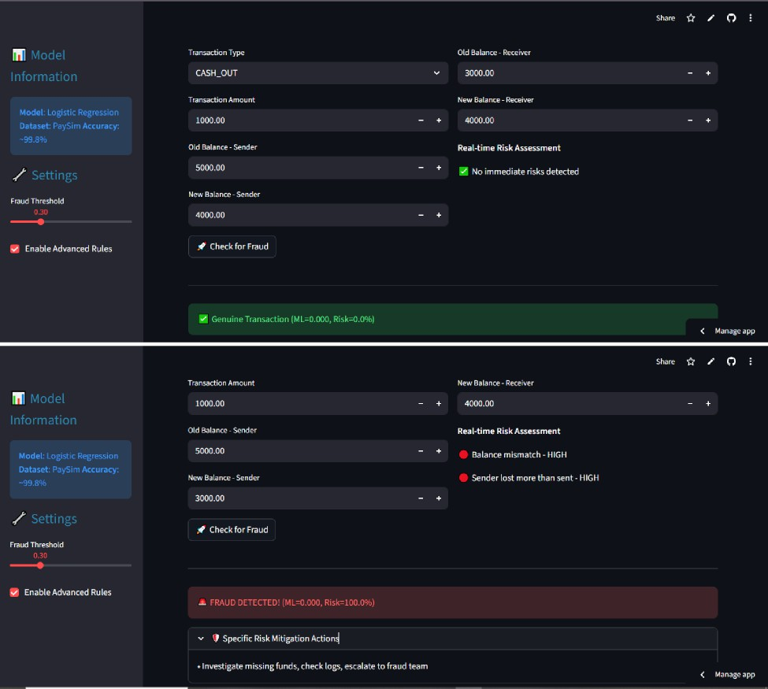
.„„ irakozechr+sz5o
Deploy an app
RA&oz&tmese0rraud
main
Fraud.py
jjv8nmx2gar6ãgdi3dzubo

